Slide 1



Introducing the CUAHSI Hydrologic Information System Desktop Application, HydroDesktop, and Open Source Development Community
Daniel P. Ames, Ph.D. P.E.
Idaho State University
Some Slides Courtesy of the CUAHSI HIS Project Team

Slide 2
Talk Overview
CUAHSI HIS Project
HydroDesktop Goals, Design, Approach
Community Development Effort
Status of Software Demo/Screen Captures

Slide 3
What is HIS?
The CUAHSI* Hydrologic Information System (HIS) provides web services, tools, standards and procedures that enhance access to more and better data for hydrologic analysis.
http://his.cuahsi.org
*Consortium of Universities for the Advancement of Hydrologic Science, Inc. http://www.cuahsi.org
Notes:
HIS helps you discover and access hydrologic data.

Slide 4
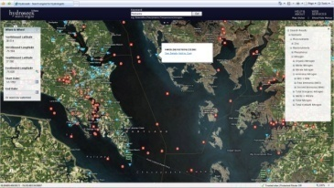

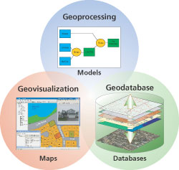
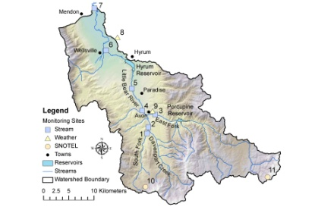
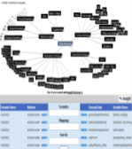
What is the CUAHSI HIS?
Discovery
Access
Modeling
Analysis
Hydroseek
HIS Desktop
HydroLink + OpenMI
MATLAB, Excel, GIS, R, …
Web services and Schema
WaterOneFlow and WaterML
GetSites
GetSiteInfo
GetVariableInfo
GetValues
to transmit hydrologic data in a standard way
Observatories
Data repository
Service Registry
3rd-Party Servers
publication and archival of field data
HIS Server
HIS Central
catalog hydrologic data services and metadata
include data from others
ODM
store and share hydrologic data
An internet based system to support the sharing of hydrologic data comprising databases connected using the internet through web services as well as software for data discovery, access and publication.
Notes:
The CUAHSI Hydrologic Information System (CUAHSI-HIS) provides web services, tools, standards and procedures that enhance access to more and better data for hydrologic analysis.
The web services use an XML based format for communicating hydrologic data, called WaterML. HIS web services support access to National Datasets such as the USGS National Water Information System (NWIS) and EPA Storage and Retrieval System (STORET), in a standard way. Users anywhere with access to the internet can save their data in a relational database format, called ODM, and register it with CUAHSI HIS to publish their data. Popular software for working with data, such as Excel, MATLAB and a variety of computer programming languages can access HIS data directly using web services. This lets users work with familiar software rather than having to learn something new.

Slide 5
Why HIS?
Academics
Recognition of work
Data publication is mandated by the funding agency
To support science in the US and promote collaboration
Agencies
Standardize data access (both internally and externally)
Time savings in developing a publication system
Public benefit with publication
Return on investment – people can get the data themselves without requiring a “middle-man”
Get all the state data “together”
Who is using HIS?
USGS, NCDC, WATERs Test Beds, several universities
More at http://his.cuahsi.org/partners.html
Notes:
The target audience for HIS was initially the academic community, but several key state and federal players have also shown interest.

Slide 6
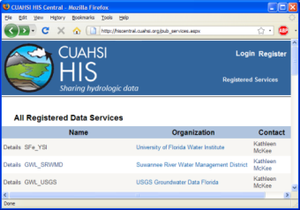
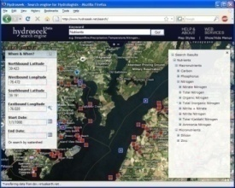
HIS System Overview
USGS
HIS Central
Metadata
Catalog
Data
Web
Service
HIS Central
HydroSeek
Data
Registration
EPA
Data
Data Access
Data Discovery
And Access
Universities
Data
HIS Servers
Users
Notes:
The HydroSeek demo that you just saw included several key pieces that participate smoothly in the HIS System. The system includes HIS Servers that provide data, HIS Central which catalogs data and assists in data discovery, and users who access data. Let’s take a closer look at HIS Server, and in particular the WaterOneFlow web service.

Slide 7
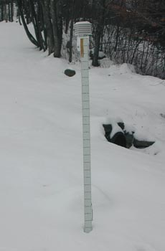
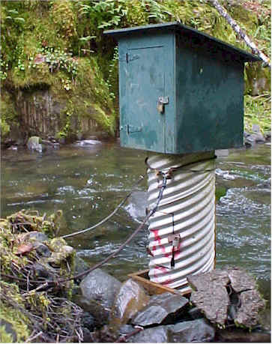
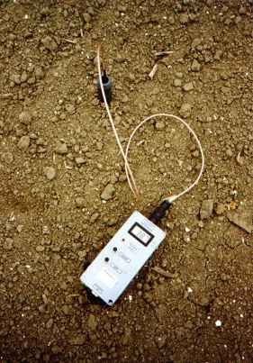
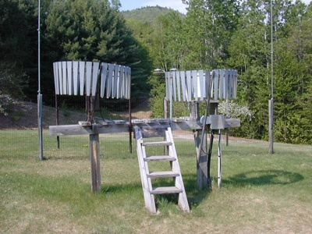
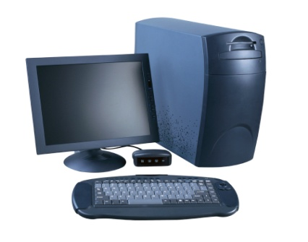
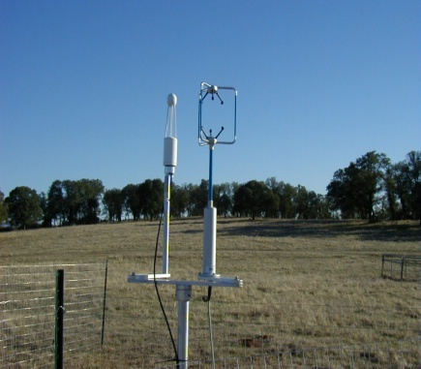
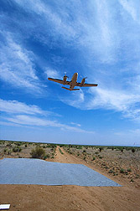
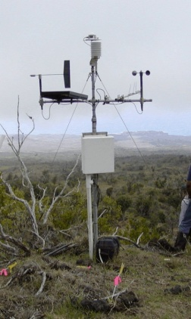
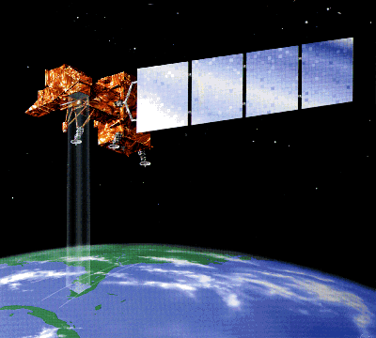
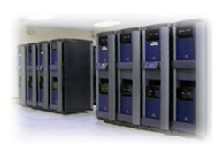
Water Data
Water quantity and quality
Soil water
Rainfall & Snow
Modeling
Meteorology
Remote sensing
Notes:
There are many types of water data.

Slide 8
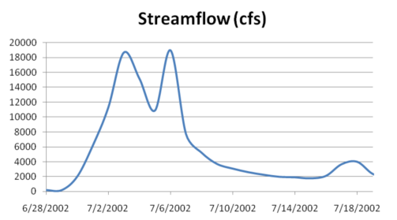
Point Water Observations Time Series
A point location in space
A series of values in time
Notes:
These data are recorded over time to monitor a hydrologic process or property.

Slide 9
The Data Cube – “what-where-when”
Time, T
“When”
t
A data value
3/4/2007
D
4.2
s
“Where”
Cane
Creek
Space, S
V_{i}
“What”
Streamflow
Variables, V
Notes:
The HIS relational database has its origins in the data cube, where a single data value is indexed by a description of what it represents, its location in space, and when it was recorded.

Slide 10
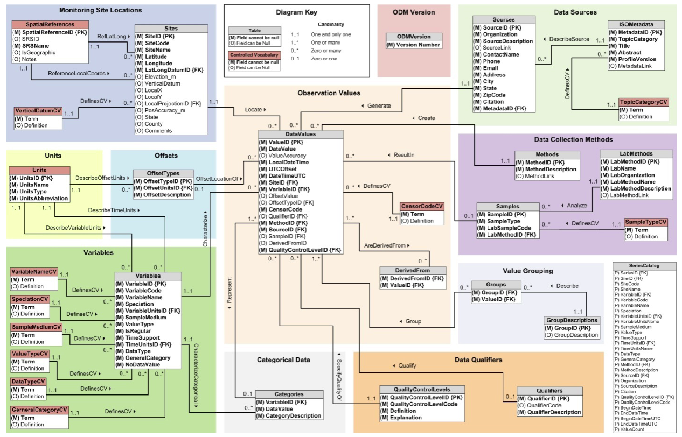
Observations Data Model
Sites
Values and Time
Variables
Horsburgh, J. S., D. G. Tarboton, D. R. Maidment and I. Zaslavsky, (2008), "A Relational Model for Environmental and Water Resources Data," Water Resour. Res., 44: W05406, doi:10.1029/2007WR006392.
Notes:
The DataValues table is at the center of the Observations Data Model, with other tables around it providing additional information using database relationships.

Slide 11
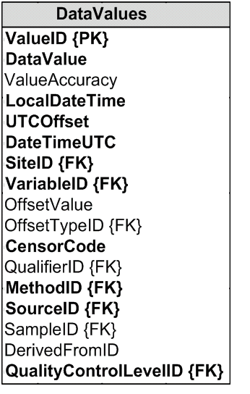
Data Values Table
Time, T
t
v_{i} (s,t)
s
Space, S
V_{i}
Variables, V
Notes:
We represent the data cube with the DataValues table. We store what, where, when, and other information for each data value in the table. (Fields highlighted in bold are required fields.)

Slide 12
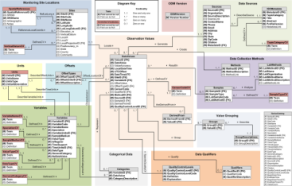
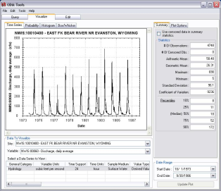
HIS Server
Data Archives
Real-time Sensors
Built for data
Storage
Loading
Analysis
Publication
HIS Software free of charge
ODM and Streaming Data Loaders
HIS Server
Observations Data Model Database
SQL Server
WaterOneFlow Web Service
ODM Tools
Outside Users
Local Users
Notes:
HIS is not just for people who want to get data. It can also be used to help publish data. HIS includes tools to assist with the entire chain of data publication, from storing data streamed in from sensors, to analyzing the data, to publishing the data with WaterOneFlow.

Slide 13
Why HIS Server
Free software for working with and publishing data
Publishing with the WaterOneFlow standard lets your data plug right in to applications like HydroExcel – it just works!
Participate in the Water Data Federation http://his.cuahsi.org/wdfederation.html

Slide 14
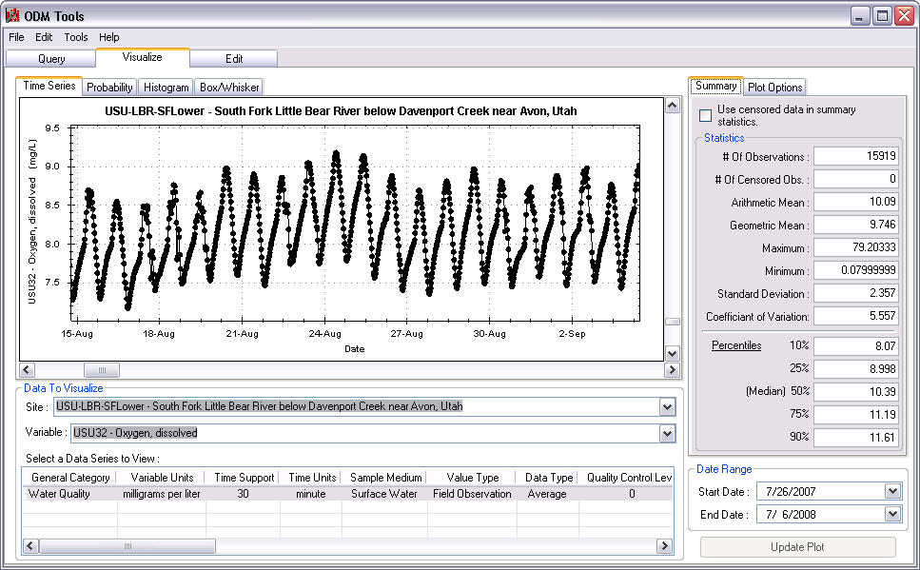

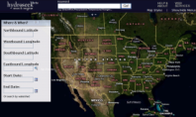
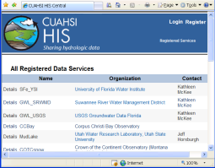


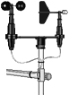
CUAHSI HIS Data Publication System
Query, Visualize, and Edit data using ODM Tools
Analysis
Access
Discovery
GIS
Matlab
Splus
R
IDL
HydroExcel
HydroGet
HydroLink
HydroObjects
HydroDesktop
Hydroseek
HydroDesktop
Java
C++
VB
ODM
Database
Service Registry
Hydrotagger
Streaming Data Loader
GetSites
GetSiteInfo
GetVariableInfo
GetValues
Base Station
Computer(s)
WaterML
Harvester
ODM Data Loader
WaterOneFlow
Web Service
Telemetry Network
Water Metadata Catalog
Excel
Text
ODM
ODM
Contribute your ODM
Sensors
HIS Central
http://his.cuahsi.org

Slide 15
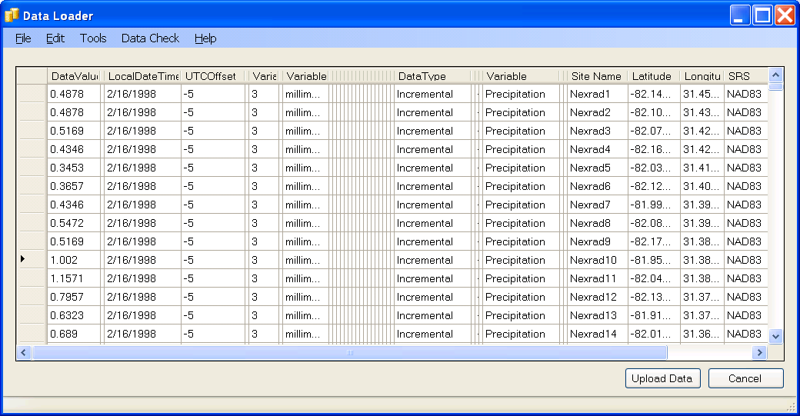
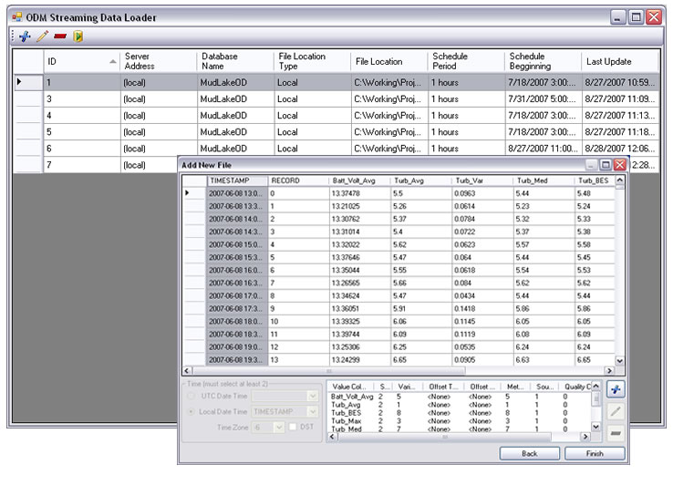
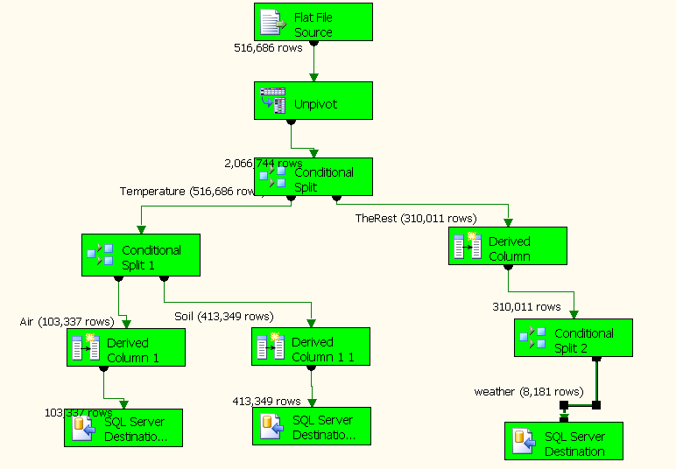
Loading data into ODM
ODM Data Loader
Interactive ODM Data Loader
Loads data from spreadsheets and comma separated tables in simple format
Streaming Data Loader (SDL)
Loads data from datalogger files on a prescribed schedule
Interactive configuration
SQL Server Integration Services (SSIS)
Microsoft application accompanying SQL Server useful for programming complex loading or data management functions
SDL
SSIS
Notes:
HIS includes two programs for loading data into ODM. The ODM Data Loader is used to load data from simple spreadsheets or CSV files, typically from archived data. The Streaming Data Loader loads data from the output of sensors which are continuously streaming in data. More advanced options for loading data include non-HIS software such as SQL Server Integration Services.

Slide 16
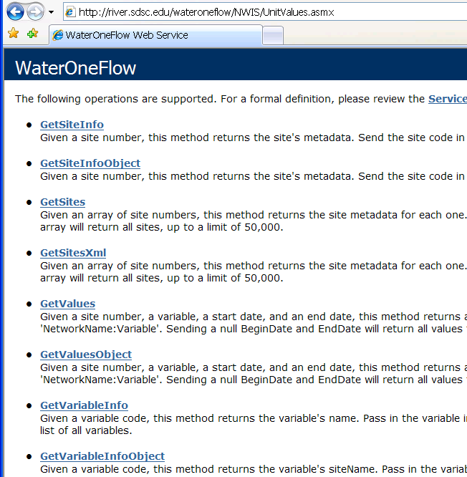
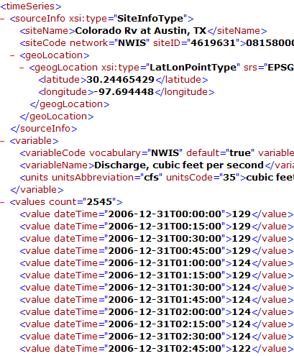
Data Publication: WaterML and WaterOneFlow
WaterML is an XML language for communicating water data
WaterOneFlow is a set of web services based on WaterML
Set of query functions
Returns data in WaterML
NWIS Daily Values (discharge), NWIS Ground Water, NWIS Unit Values (real time), NWIS Instantaneous Irregular Data, EPA STORET, NCDC ASOS, DAYMET, MODIS, NAM12K, USGS SNOTEL, ODM (multiple sites)
Slide from David Valentine
Notes:
16

Slide 17
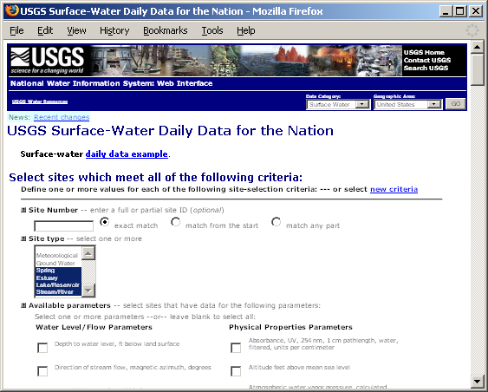
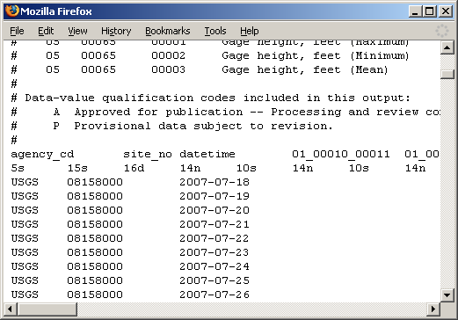
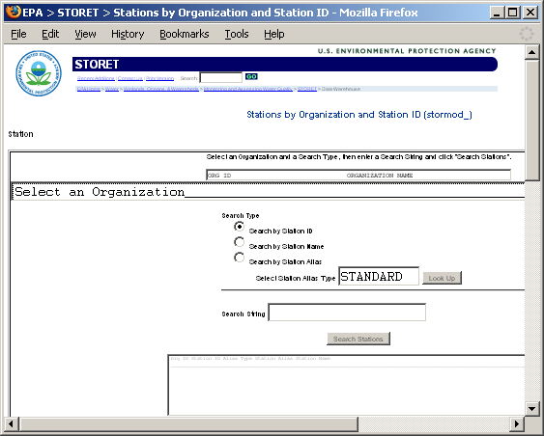
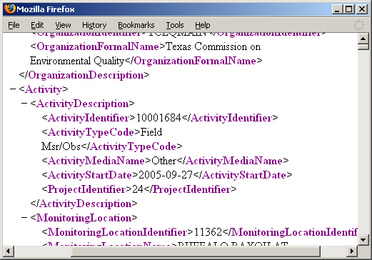
Getting Water Data (the old way)
Different Query Pages
Different Query Responses
Notes:
Much hydrologic data are online. However, each website has a different form for querying data, and each website returns data in a different format.

Slide 18
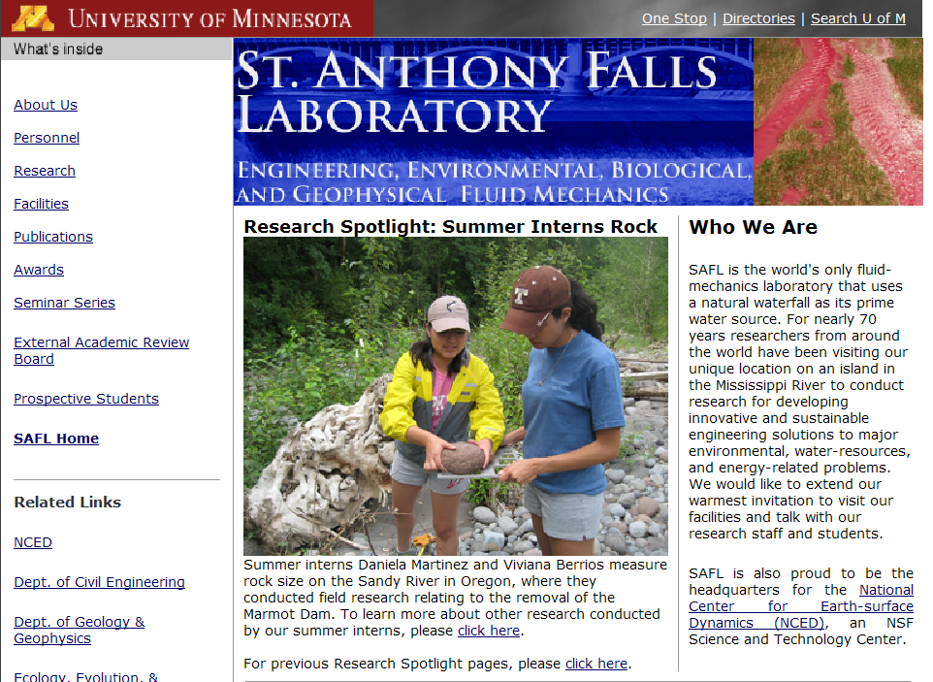
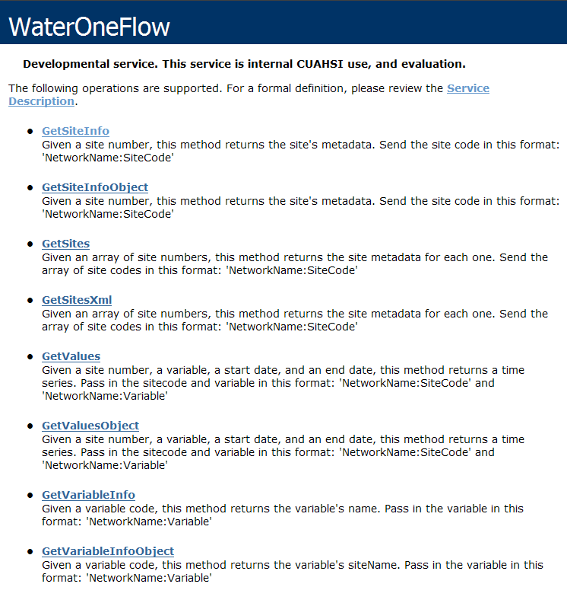
Web Pages versus Web Services
http://www.safl.umn.edu/
http://his.safl.umn.edu/SAFLMC/cuahsi_1_0.asmx
Uses Hypertext Markup Language (HTML)
Uses WaterML
(a Markup Language for water data)
Notes:
To standardize data access, we’ll move beyond web pages, and use web services.

Slide 19
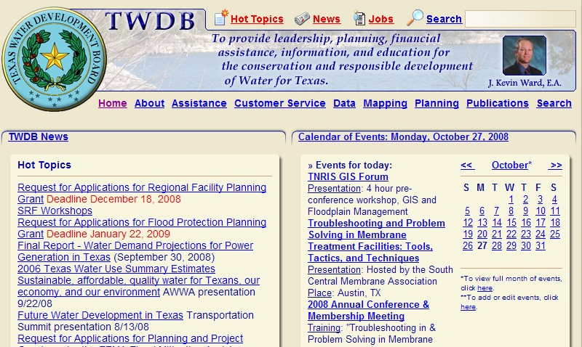
HTML as a Web Language
HyperText
Markup Language
Text and Pictures
in Web Browser
<title>Texas Water Development Board</title>
<!DOCTYPE HTML PUBLIC "-//W3C//DTD HTML 4.01 Transitional//EN">
<html>
<head>
<meta name = "Robots" content = "index,follow">
<meta name = "Priority" content = "home,twdb,homepage">
<meta name = "Author" content = "Texas Water Development Board, Agency Number 580">
<meta name = "Title" content = "Texas Water Development Board">
<meta name = "Description" content = "Texas Water Development Board Home Page">
<meta name = "Keywords" content = "water,drought,rain,conservation,groundwater,surfacewater,lake,reservoir,hydrology,geology,desalination,TWDB,loans,grants,wastewater,sewage,Clean Water,Drinking Water,State Revolving Fund,planning,State Water Plan,GIS,Geographic Information Systems,Mapping,data">
Notes:
You’re probably aware that we use HTML as a web language for rendering web pages.

Slide 20
WaterML and WaterOneFlow
WaterML is an XML language for communicating water data
WaterOneFlow is a set of web services based on WaterML
Set of query functions
Returns data in WaterML
Slide from David Valentine
Notes:
20

Slide 21
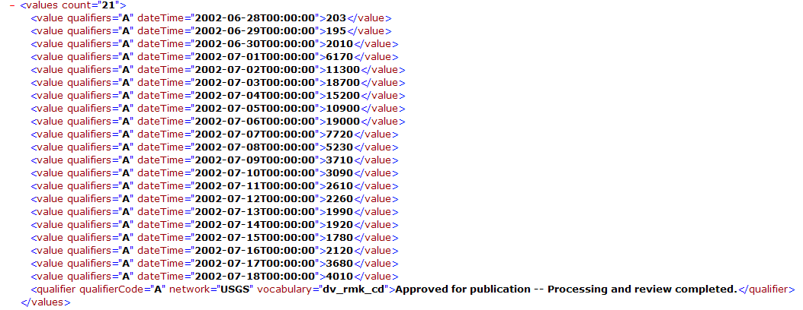
WaterML as a Web Language
Discharge of the San Marcos River at Luling, June 28 - July 18, 2002
Streamflow data in WaterML language
Notes:
In HIS, we created a language called WaterML for describing water data. We won’t be going into the details of the XML structure of WaterML, because like HTML, you can rely on software to interpret WaterML for you.

Slide 22
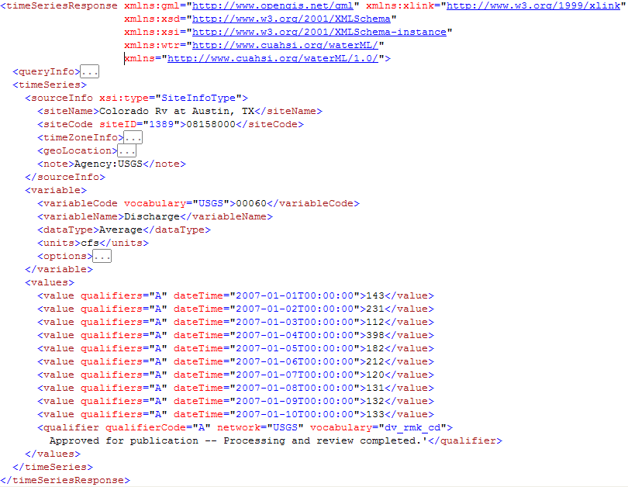

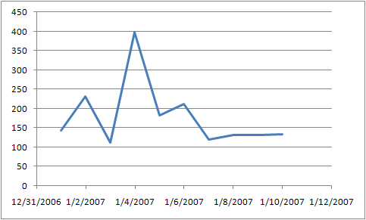
WaterML includes location, variables, and time series
location
variable
time series

Slide 23
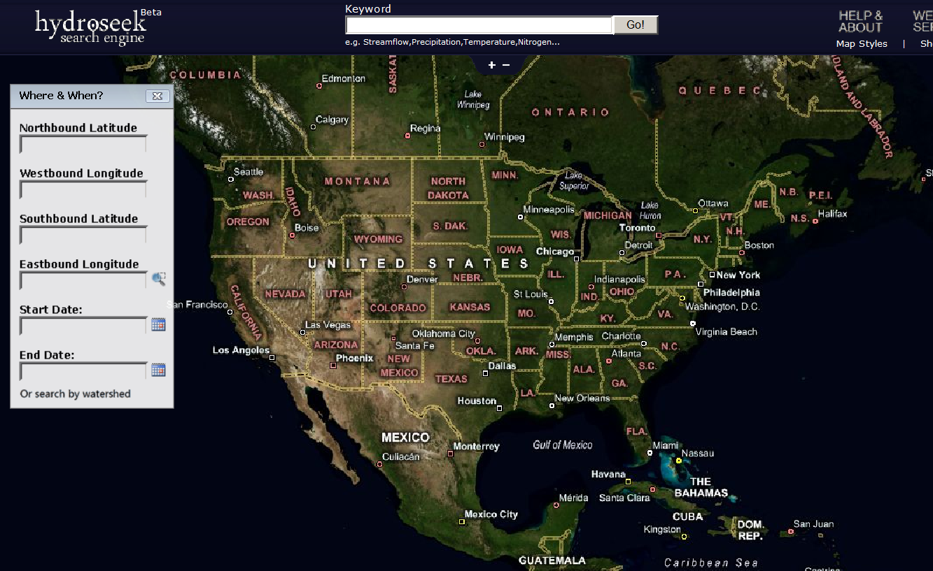
Hydroseek http://www.hydroseek.org
Bora Beran, Drexel
Supports search by location and type of data across multiple observation networks including NWIS and Storet

Slide 24
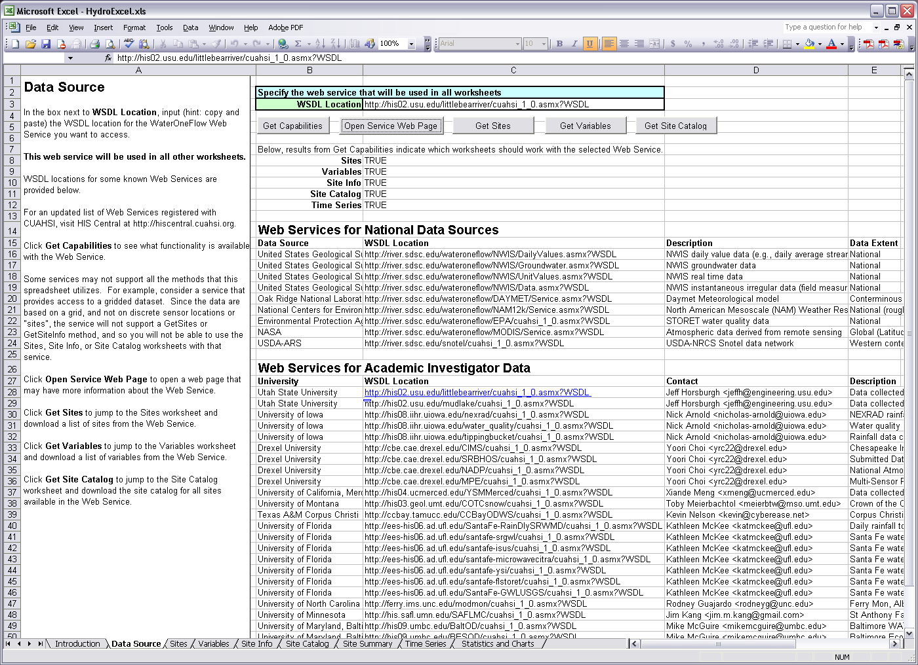
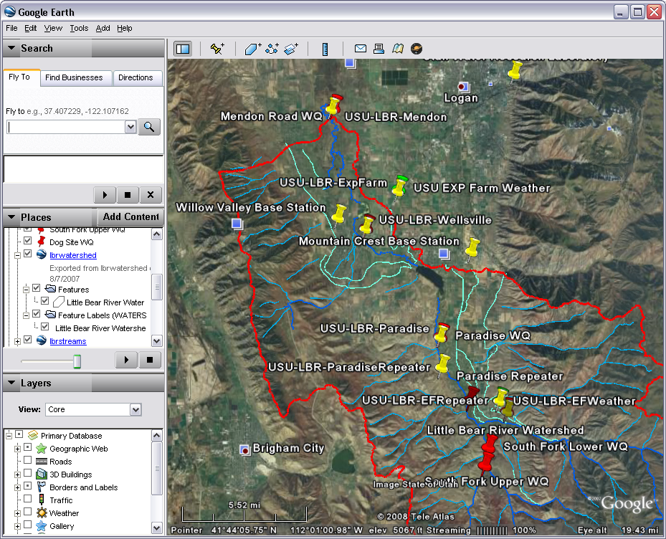
Direct analysis from your favorite analysis environment. e.g. Excel

Slide 25

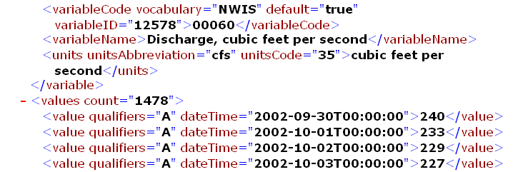
Direct analysis from your favorite analysis environment. e.g. Matlab
% create NWIS Class and an instance of the class
createClassFromWsdl('http://river.sdsc.edu/wateroneflow/NWIS/DailyValues.asmx?WSDL');
WS = NWISDailyValues;
% GetValues to get the data
siteid='NWIS:02087500';
bdate='2002-09-30T00:00:00';
edate='2006-10-16T00:00:00';
variable='NWIS:00060';
valuesxml=GetValues(WS,siteid,variable,bdate,edate,'');

Slide 26

ISU/Idaho EPSCoR Key Contribution
Notes:
HydroDesktop is a desktop based software application that serves as a client for HIS Services. This project is being supported by CUAHSI, Idaho EPSCoR and the Inland Northwest Research Alliance.

Slide 27
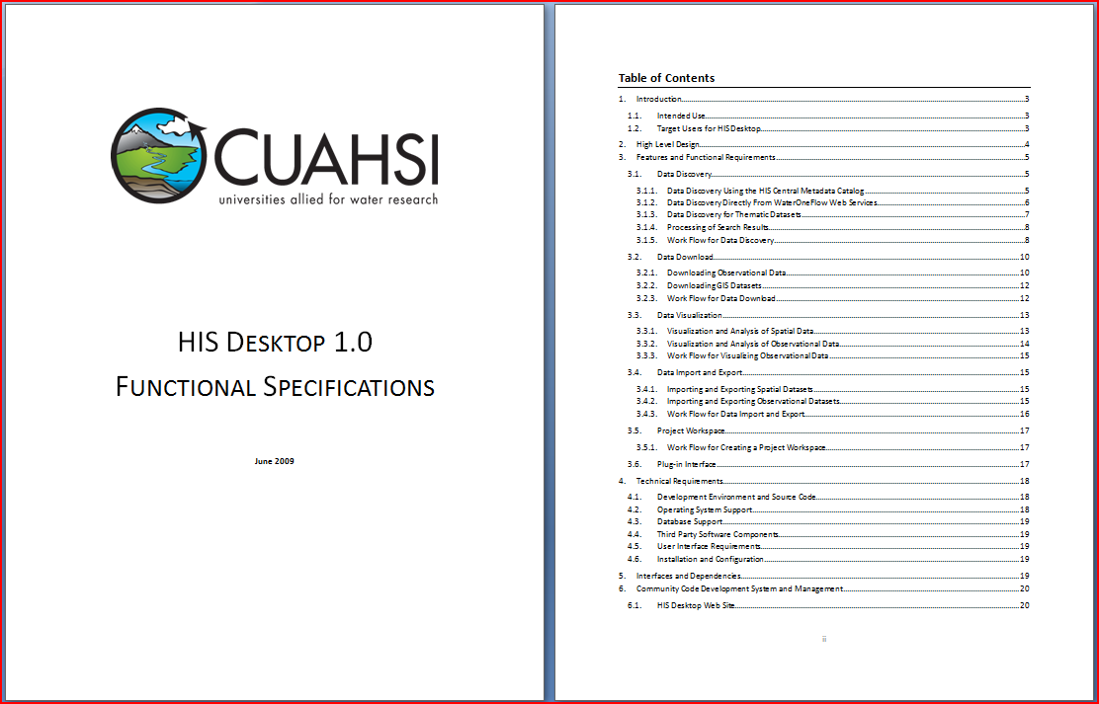
HydroDesktop Design Specifications
A web-based collaborative software design and development environment was set up on CodePlex.com. This site includes a discussion forum, wiki, source code repository and versioning system, and bug/issue tracking system.

Slide 28
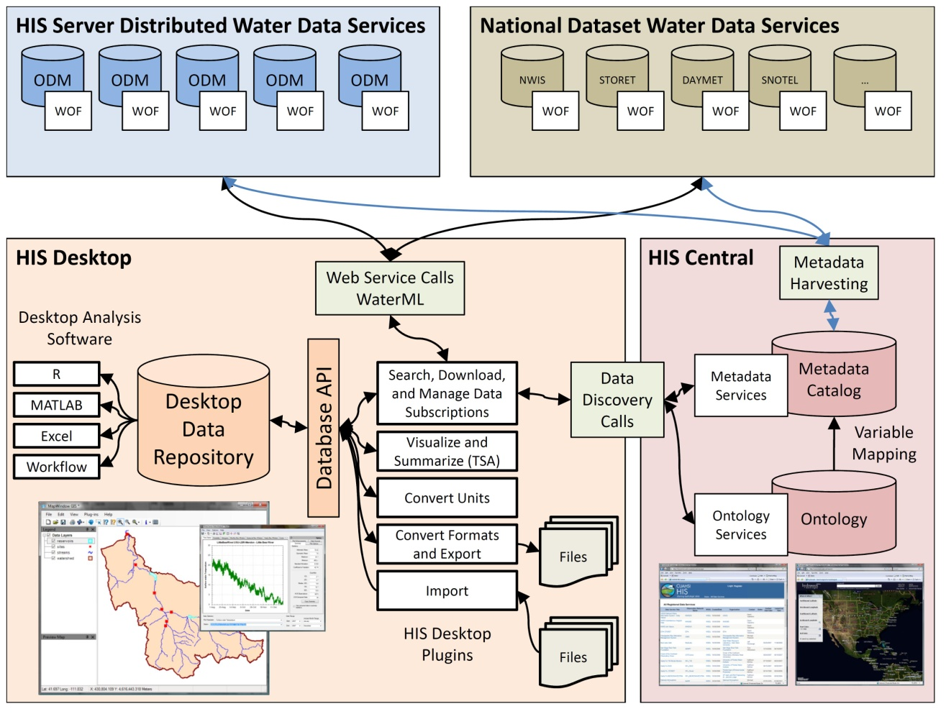
Notes:
HydroDesktop will be a key component of the HIS Project and serves as a desktop client to provide access to HIS Services. HydroDesktop will include capabilities for data discover, download, visualization, modification and export through a simple open source GIS based desktop application.

Slide 29
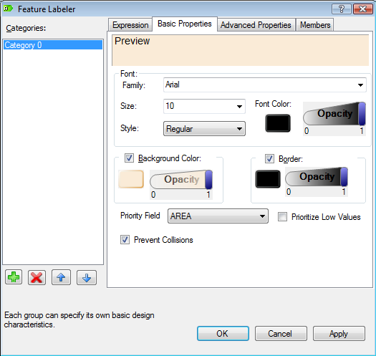
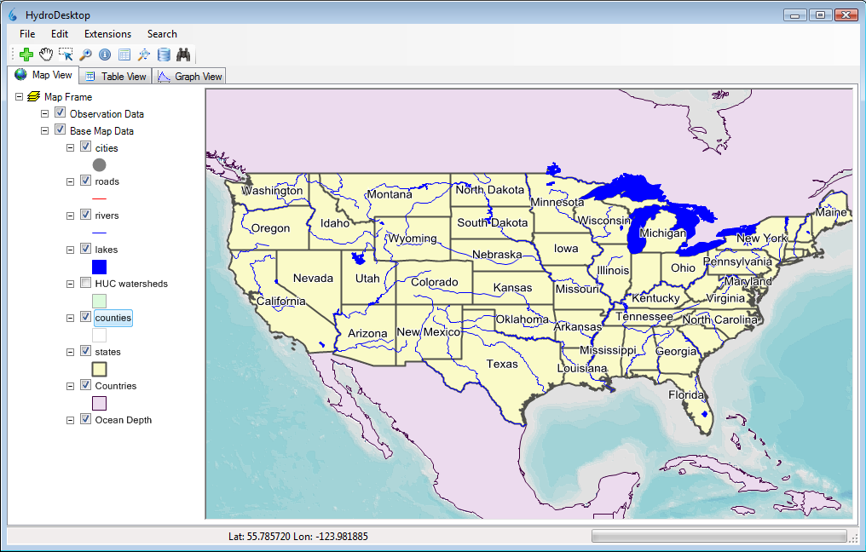
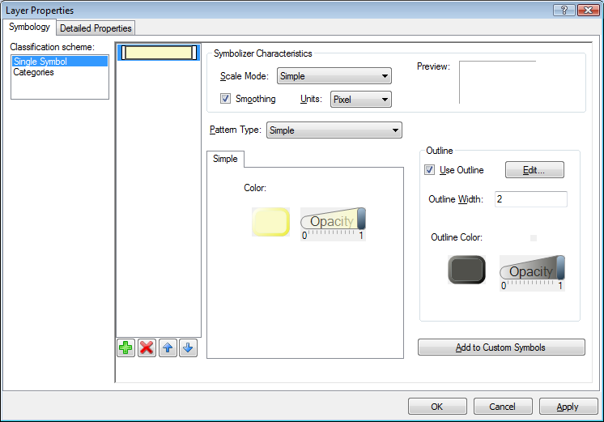
HydroDesktop GIS Capabilities
GIS
Hydrology
Add shapefiles to map
Change symbology and labels
Print and export map
GIS toolbox and Modeler
Search for data
Download data
Display time series
Export data

Slide 30
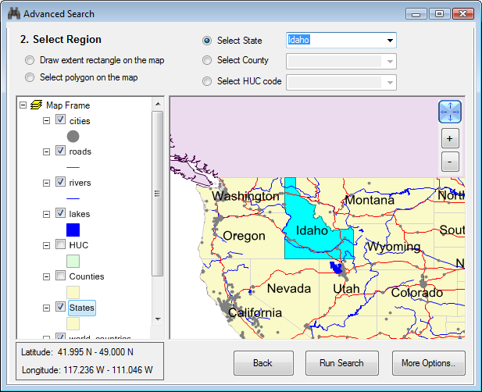
HydroDesktop Data Search
Search Criteria
Region
Keywords (variable)
Time range
Web services
Example:
Snow in Idaho
2000 - 2009
Notes:
User can search for available data by geographic region, variable, time range and web service. The variable, time range and web service criteria are optional.

Slide 31
HydroDesktop Data search – select region
Region selection
Draw bounding box
Select polygons
Select State
Select County
Select HUC Code
Notes:
User can search for available data by geographic region, variable, time range and web service. The variable, time range and web service criteria are optional.

Slide 32

HydroDesktop Data search – select keywords
Notes:
One or more keywords can be selected. The list of available keywords is retrieved from HIS Central

Slide 33


HydroDesktop Data search – Search Results
Snow - Idaho
Notes:
Search results are shown in a map and in a table. User can refine the search by selecting a subset of data series in the table or map.

Slide 34


HydroDesktop Data Download
Notes:
After refining the search, HydroDesktop connects to one or more WaterOneFlow web services and downloads the observation data. The downloaded data is stored in a local SQLITE database. The measurement sites are displayed on the map as a new theme.

Slide 35

HydroDesktop Plug-in Development
Plugins
HydroDesktop.exe
AdvancedSearch.dll
HydroModeler.dll
DataFetcher.dll
MapWindow.dll
HydroDesktop.Database.dll
Existing plugins
Advanced Search
Metadata Fetcher
HydroModeler (Open MI)
Notes:
The functionality of HydroDesktop can be extended by plug-ins. Each plug-in needs to reference the library MapWindow.dll and implement the MapWindow 6 plugin interface. Any existing MapWindow 6 GIS plug-in can be used as a HydroDesktop plug-in. To easily access data from the HydroDesktop local database, a plugin can use functions from the HydroDesktop.Database.dll library (data abstraction layer)

Slide 36




HydroDesktop Collaborative Development
A web-based collaborative software design and development environment was set up on CodePlex.com. This site includes a discussion forum, wiki, source code repository and versioning system, and bug/issue tracking system.
www.HydroDesktop.org
Notes:
HydroDesktop development is following the open source model and is housed at the Microsoft CodePlex web site. The project can be accessed through the link:www.hydrodesktop.org and is open for public participation in the project. The collaborative development portal includes a project WIKI with information about the project, a Downloads page for current installers and releases of the software, a Discussion Forum for open discussions and questions about the project, an Issue tracker for managing bugs, features, and issues. Also direct access to source code is available for anyone (authorized users are invited to contribute source code directly to the project). HydroDesktop is licensed under the BSD open source license which allows it to be used in commercial, non-commercial, academic, government or other settings as needed.

